Slide 1
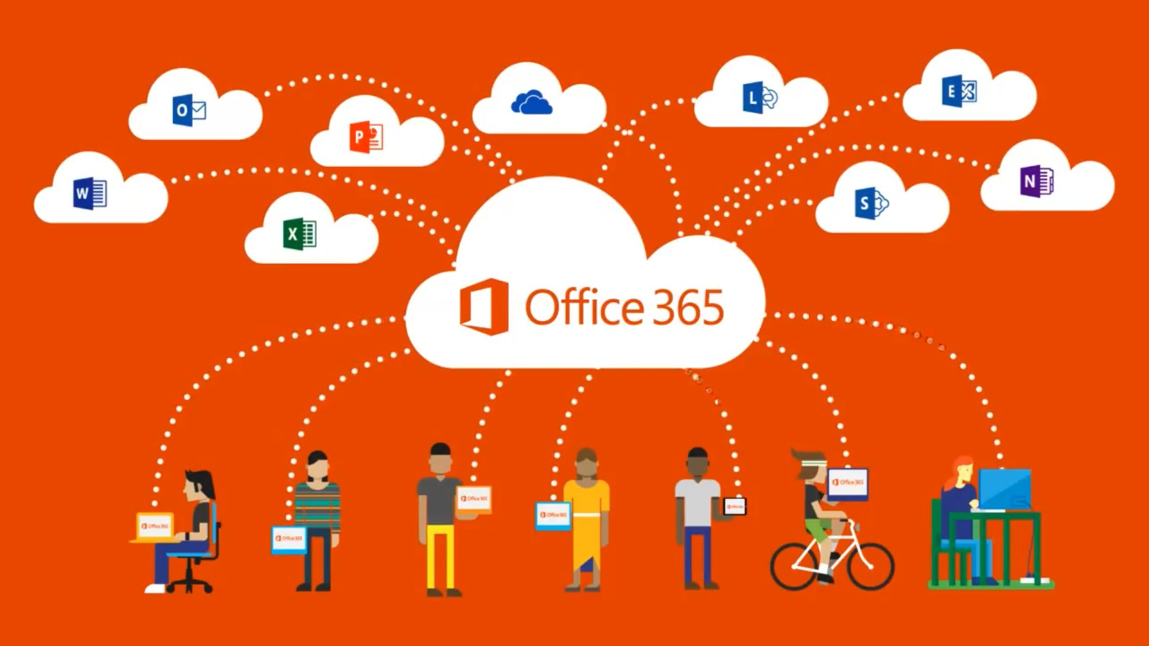
Beginning Office 365 and One Drive Basics
Think of it as an Office Building with all different departments inside.

Slide 2
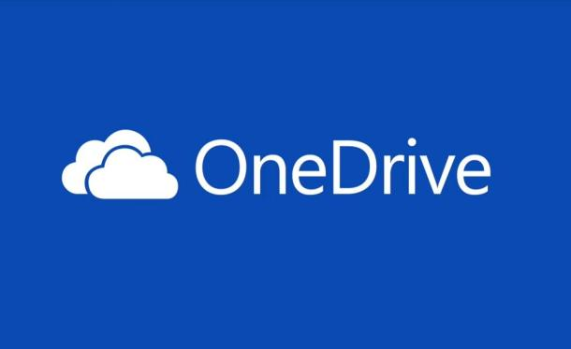
What is ?
Think of OneDrive as a huge storage closet inside the Office Building.

Slide 3
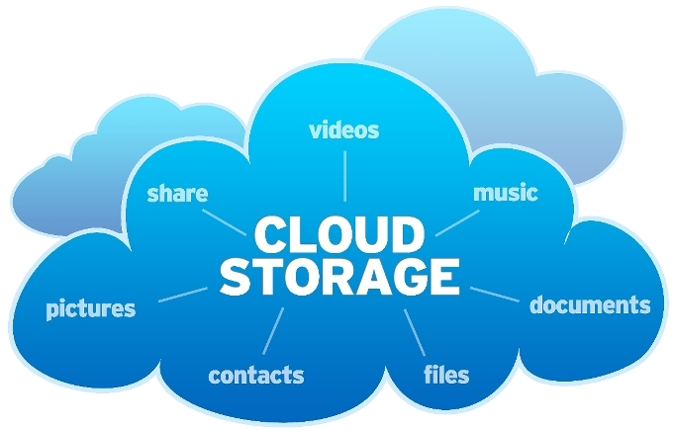
Why does everyone call it a cloud?? What does that even mean???
Think of it as a cloud that follows you wherever you go! (As long as you have internet connection, you can get into your Office Building!)

Slide 4
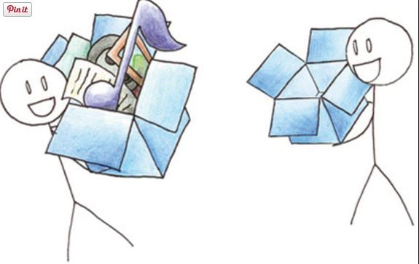
It’s like Dropbox on vitamins!!
Dropbox is a wonderful means of cloud storage that acts like a separate “drive” or location ON your computer. Dropbox space is limited. OneDrive isn’t limited and can do a LOT more!!!

Slide 5
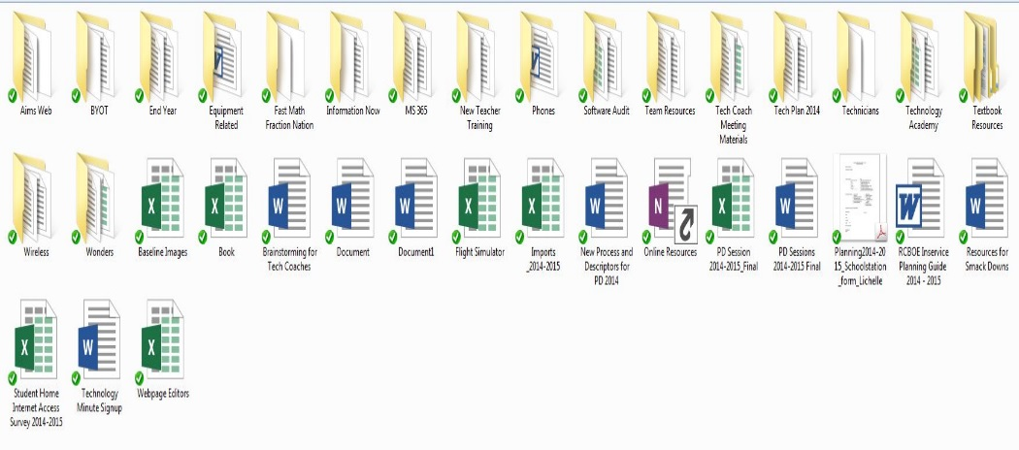
Organize folders and
SYNC from computer cloud!!

Slide 6
That’s Not All!!
Delve – Search EVERYTHING 365 (emails, attachments, files, folders, videos, etc.)
Skype – video/audio conference, share desktop, tutorials, etc.
Video Portal – Internal “RCS YouTube”
Office Apps – Word, Excel, PowerPoint, Email, Calendar, Publisher, and MORE!

